Slide 1
Deep Learning
Đỗ Trọng Hợp
Khoa Khoa Học và Kỹ Thuật Thông Tin
Đại học Công Nghệ Thông Tin TP. Hồ Chí Minh

Slide 2
Improving Deep Neural Network

Slide 3
Setting up your ML application

Slide 4
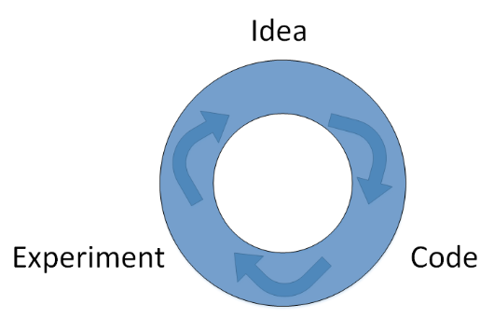
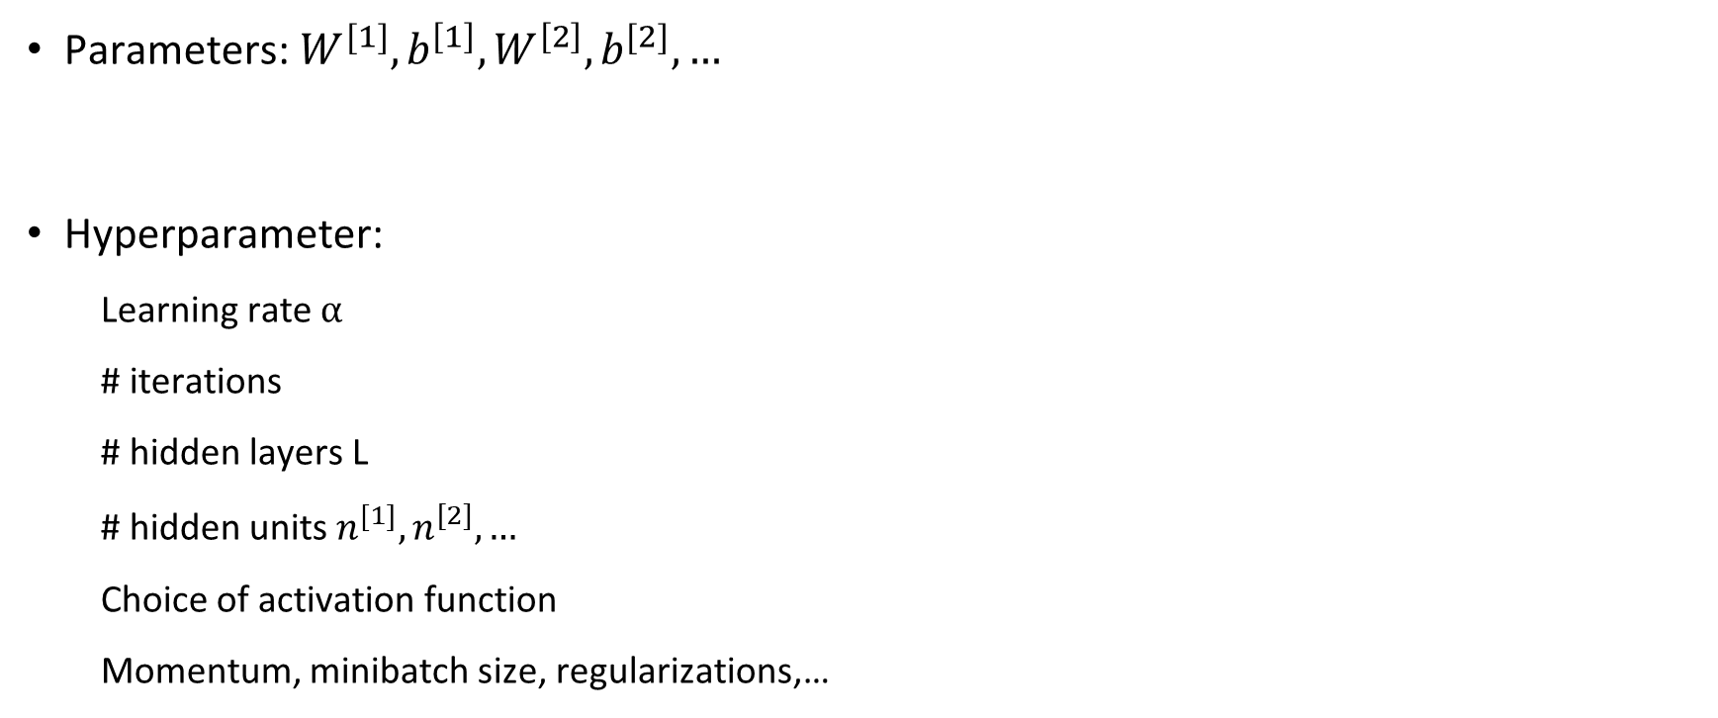
Parameters vs Hyperparameters
Parameters: $W^{[1]}, b^{\left[1\right]},W^{\left[2\right]},b^{[2]},…$
Hyperparameter:
Learning rate $α$
# iterations
# hidden layers L
# hidden units $n^{\left[1\right]},n^{[2]},…$
Choice of activation function
Momentum, minibatch size, regularizations,…

Slide 5
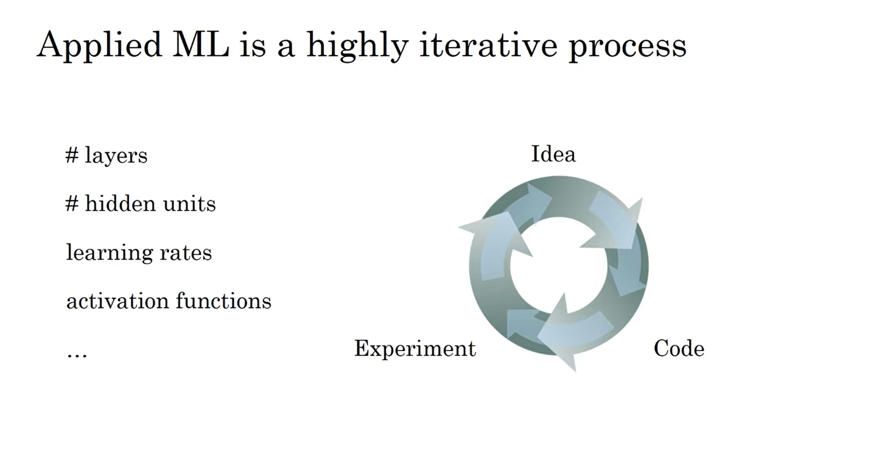

Slide 6
Train/Dev/Test Sets
Development set: used to check the network performance to make necessary changes
Data
Training
Dev
Test
Test set is used to get unbiased estimation of the network performance
Era of small data: 70% data for training
Era of big data: 99% data for training
Make sure training set and test set come from the same distribution
Not having a test set might be OK. (Only dev set)

Slide 7
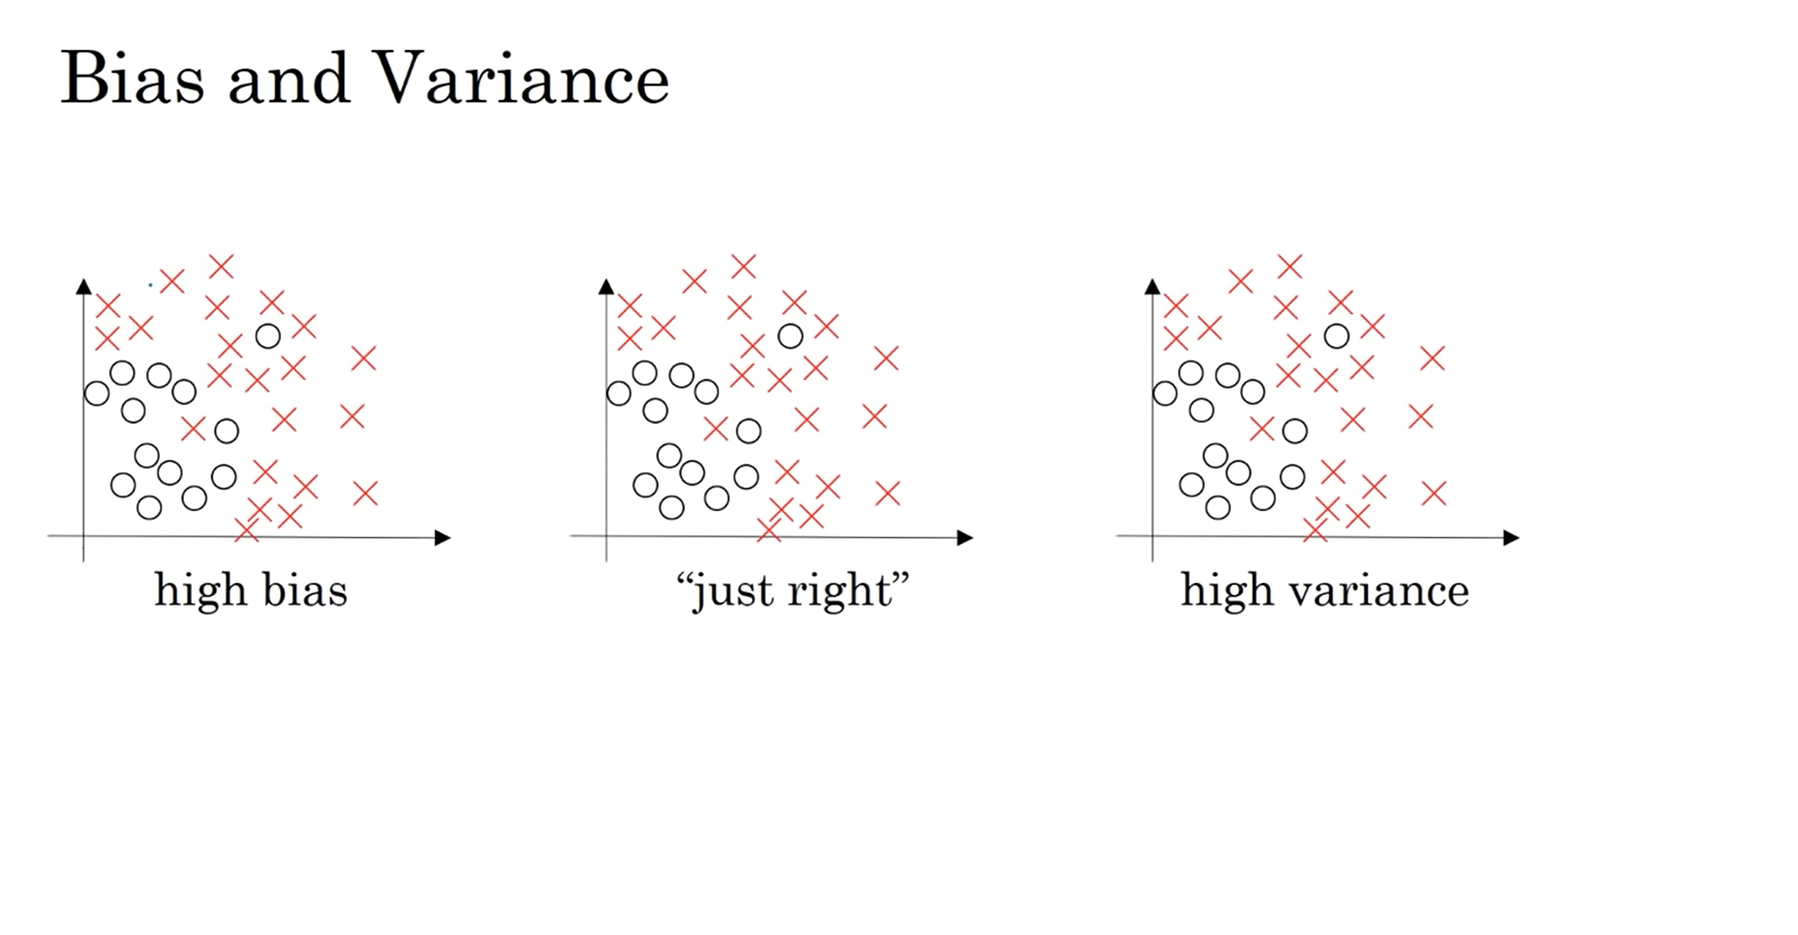
(Error)
Underfitting
Overfitting

Slide 8
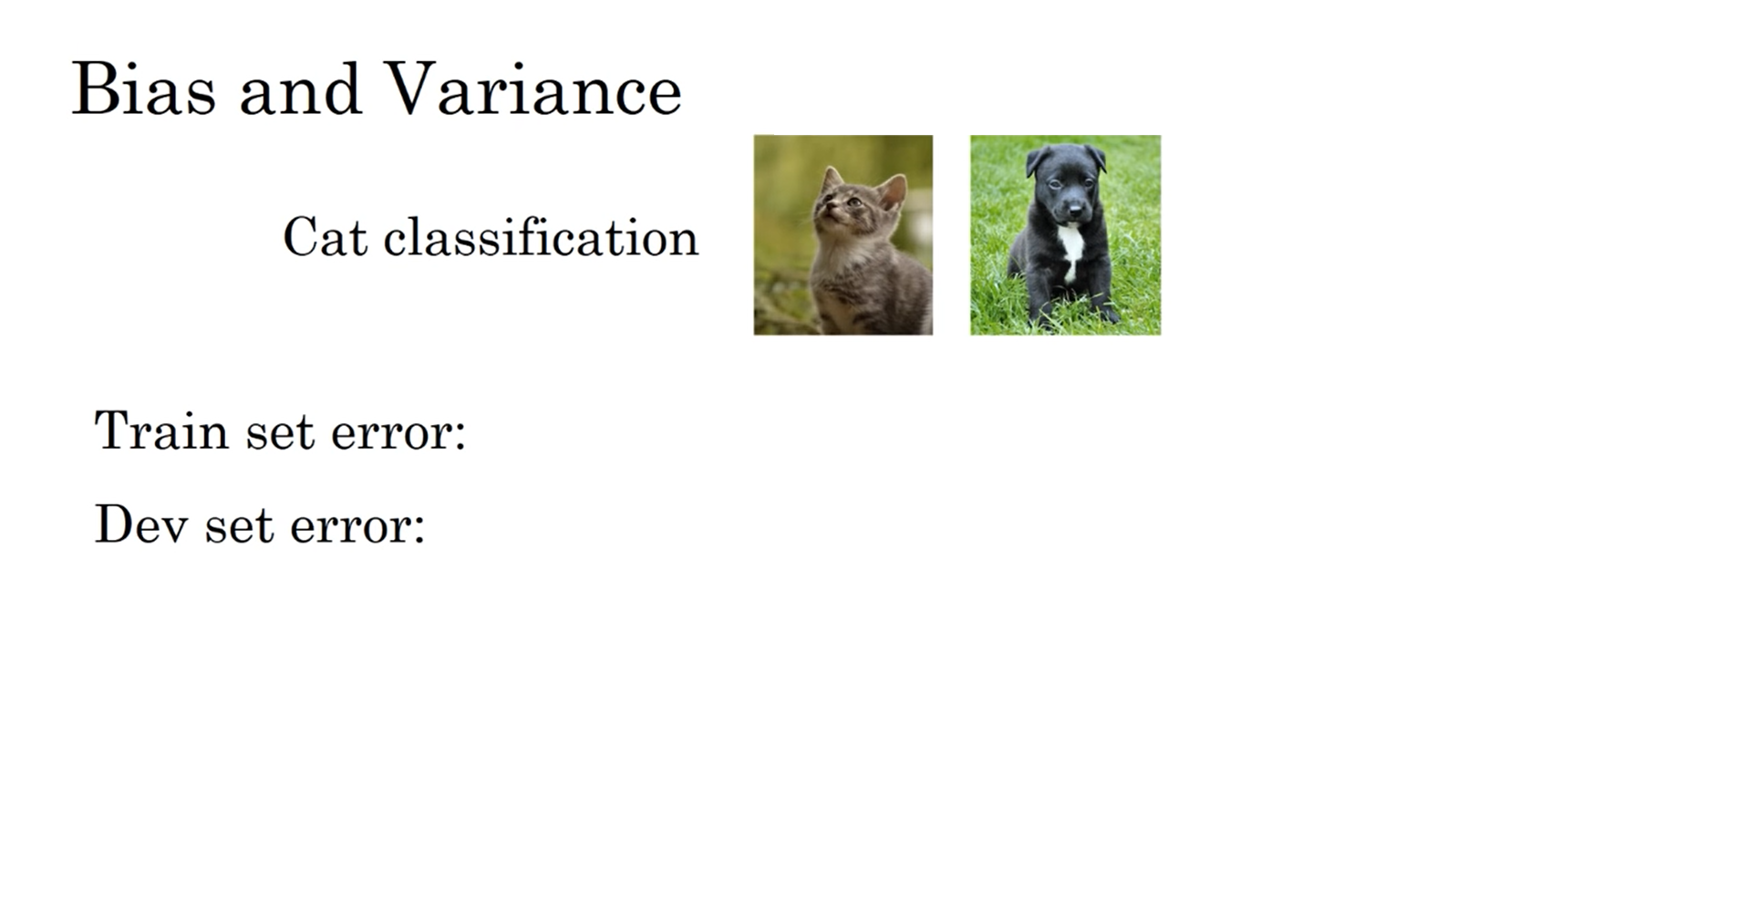
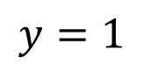
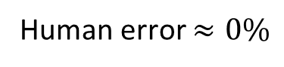
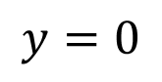
$$y=1$$
$$y=0$$
Human error $≈0\%$
1% | 15% | 15% | 0.5%
11% | 16% | 30% | 1%
high variance | high bias | high bias & high var | low bias & low var

Slide 9
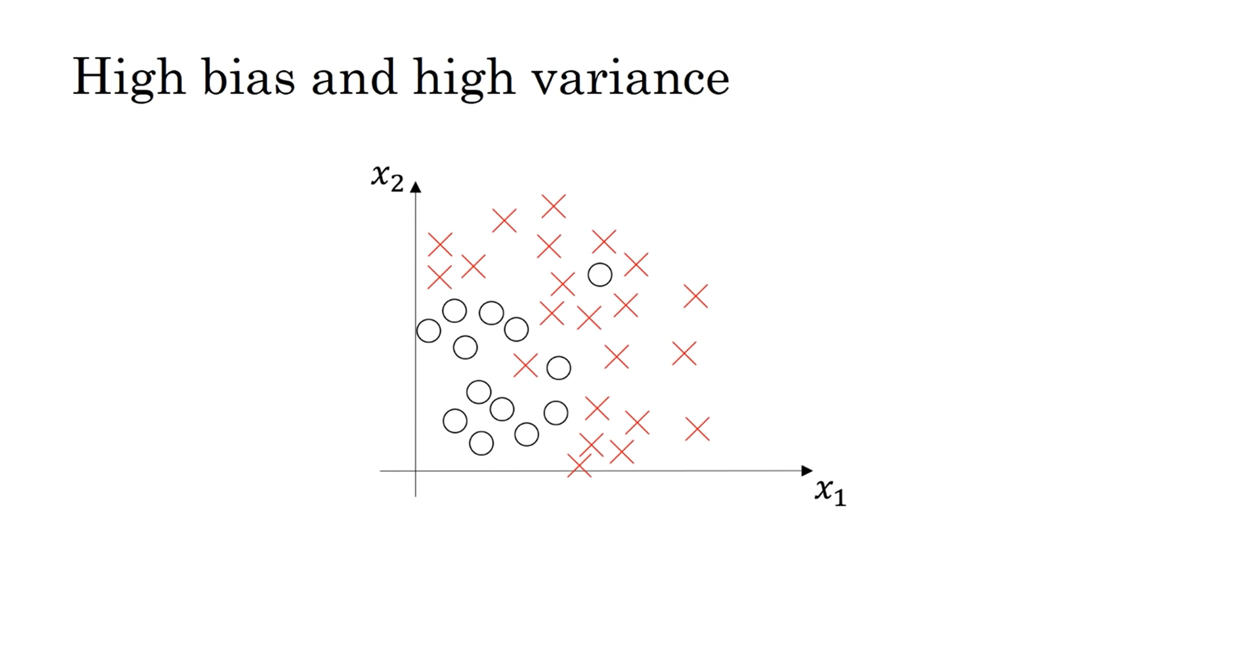

Slide 10
Basic recipe for machine learning
High bias?
Y
Bigger network
Train longer
(Other architecture)
(training data performance)
N
Y
More data
Regularization
(Other architecture)
High variance?
(dev set performance)
N
Done

Slide 11
Basic recipe for machine learning
High bias?
Y
Bigger network
Train longer
(Other architecture)
(training data performance)
N
High variance?
Y
More data
Regularization
(Other architecture)
(dev set performance)
N
Done

Slide 12
Regularization

Slide 13
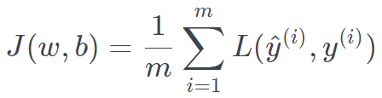
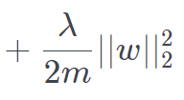
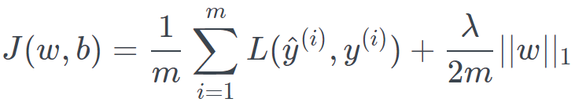
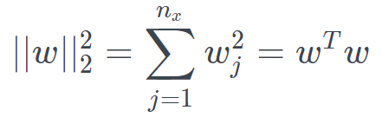
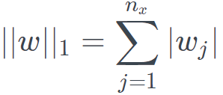
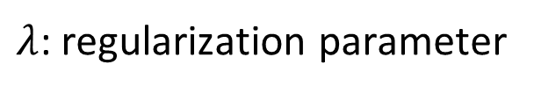
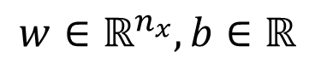
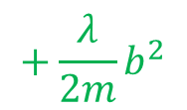
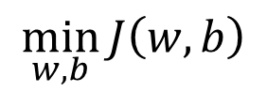
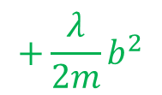
Regularization for logistic regression
$$\min_{w,b}{J\left(w,b\right)}$$
$$w∈ℝ^{n_{x}},b∈ℝ$$
$λ$: regularization parameter
$$+\frac{λ}{2m}b^{2}$$
$$+\frac{λ}{2m}b^{2}$$
L2 regularization:
L1 regularization:
After regularization, $w$ will be sparse (i.e. having many zero elements)
Notes:
Why no regularization for b? Usually w is a high-dimensional vector, covering almost all parameters, and have high variance problem. So the parameters are largely determined by w. We can add regularization for b but it does not help much.
After regularization, w will be sparse (meaning that w will have many zero elements).
L1 regularization makes w more sparse but it does not help much for the high variance problem.
Since L1 is is more complicated in terms of differentiation, L2 is used more often in practice.

Slide 14
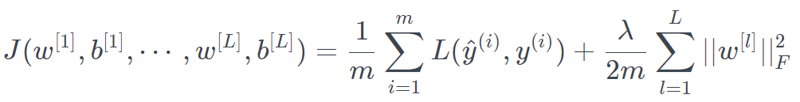
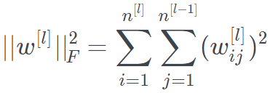
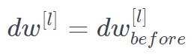
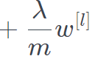
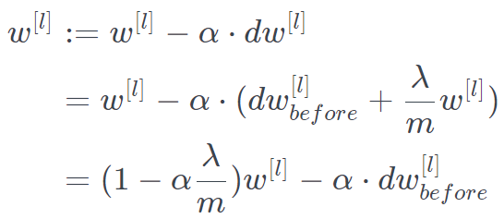
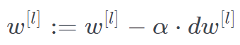
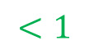
Regularization for Neural network
$$<1$$

Slide 15
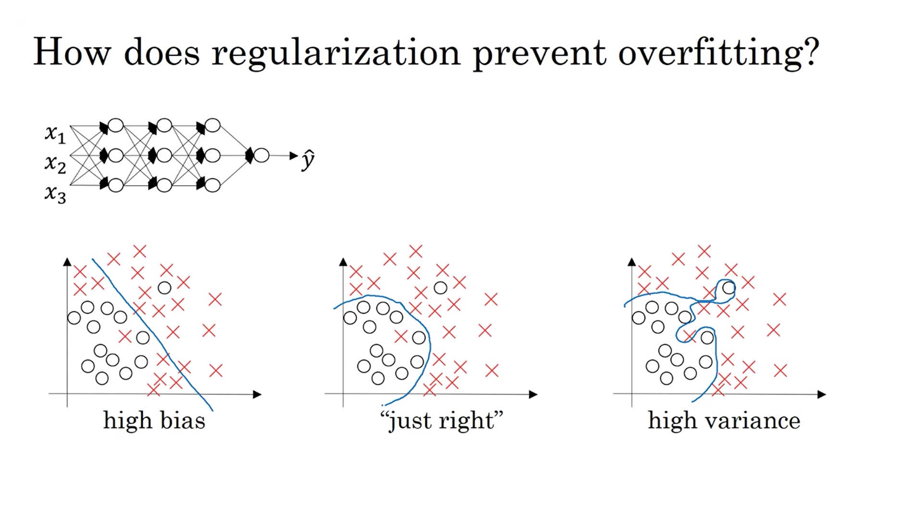
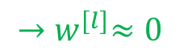
$${→w}^{[l]}≈0$$
Notes:
After regularization, w become small (even close to zero). This eliminates the effect of many hidden units and make the network simpler.
By adjusting the parameter lambda, we can adjust the complexity of the network to just right level.

Slide 16
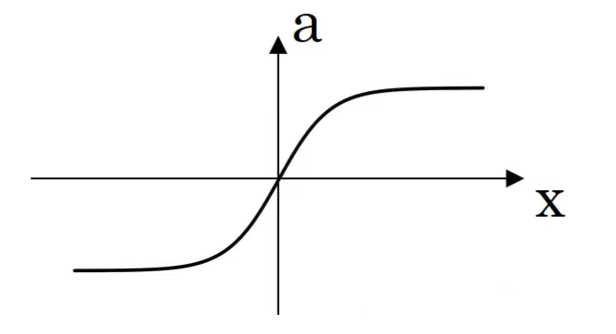
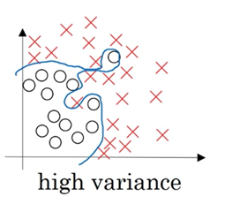
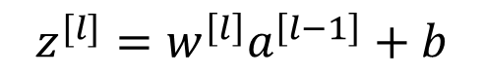

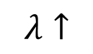
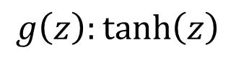
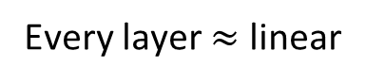
How does regularization prevent overfitting?
$$g\left(z\right):\tanh\left(z\right)$$
non-linear
linear
non-linear
$$λ↑$$
$$w^{\left[l\right]}↓$$
$$z^{[l]}=w^{\left[l\right]}a^{\left[l−1\right]}+b$$
Every layer $≈$ linear
Notes:
When every layers are near linear, there cannot be complicated non-linear classification and thus no overfitting.

Slide 17
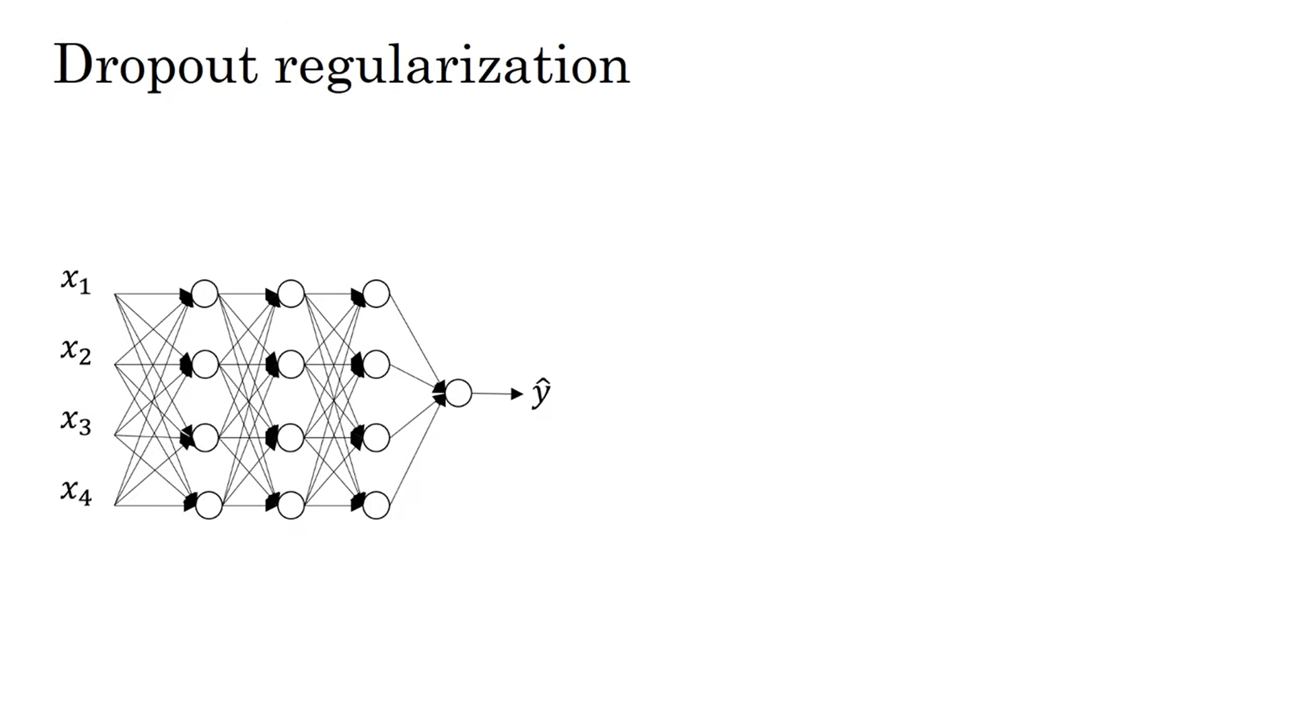
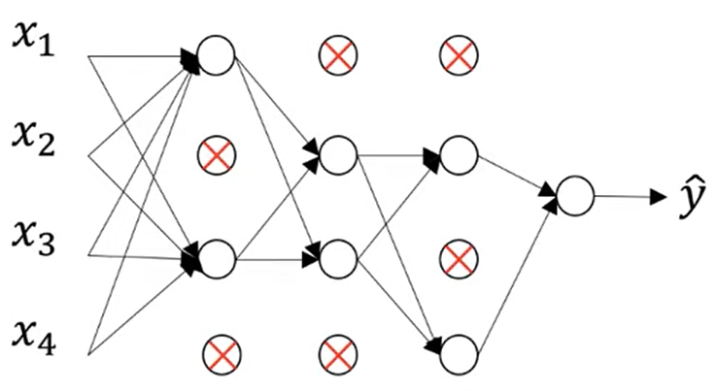
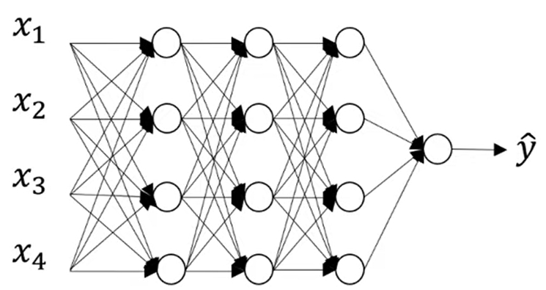
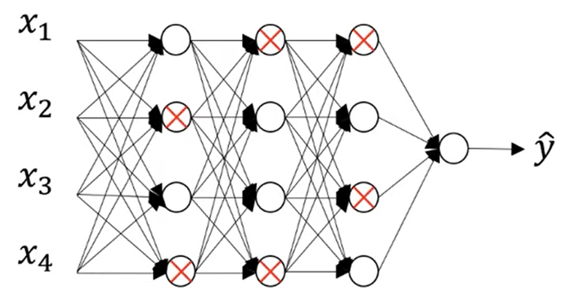
Dropout probability = 0.5
Notes:
With dropout, we go through the network and set a probability of eliminating each node in the network.
After eliminating nodes, we also remove ingoing and outgoing links from that node. So we end up with a much smaller network.
Then we do backpropagation and training on this much smaller network.
In other training example, we toss the coin again and eliminate other set of nodes.
For each training example, you train on a different smaller network.

Slide 18
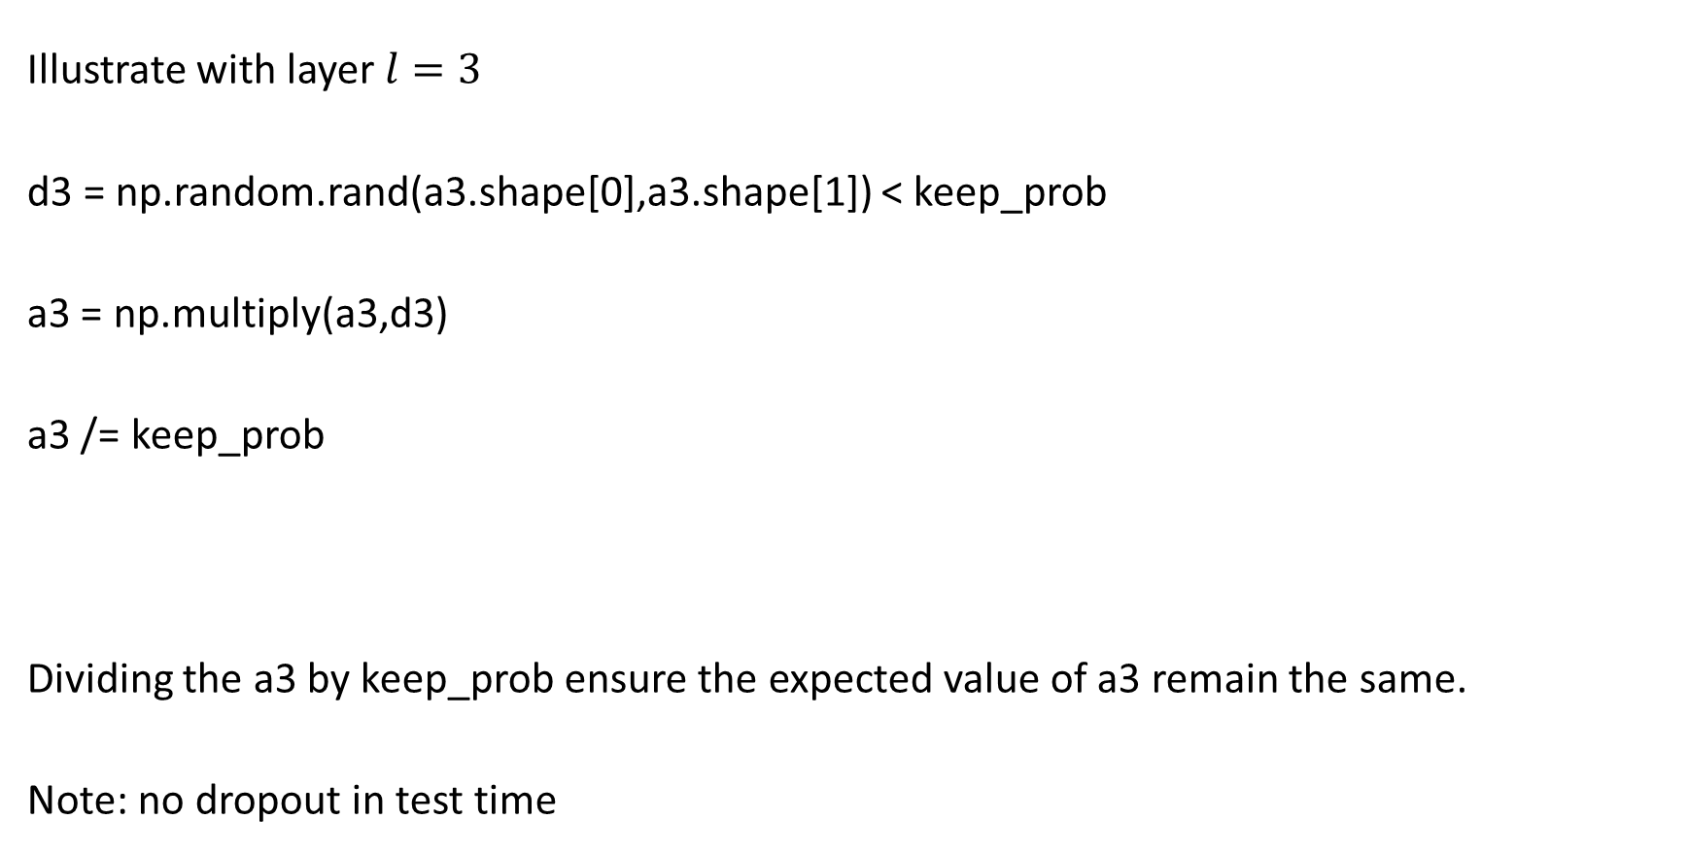
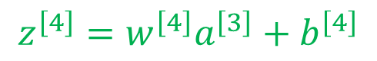
Implementing dropout (“Inverted dropout”)
Illustrate with layer $l=3$
d3 = np.random.rand(a3.shape[0],a3.shape[1]) < keep_prob
a3 = np.multiply(a3,d3)
a3 /= keep_prob
Dividing the a3 by keep_prob ensure the expected value of a3 remain the same.
Note: no dropout in test time
(keep_prob = 0.8)
100 units
20 units shut off
$$z^{\left[4\right]}=w^{\left[4\right]}a^{\left[3\right]}+b^{\left[4\right]}$$
reduce by 20%
Notes:
In each iteration, we will zero out different units.

Slide 19
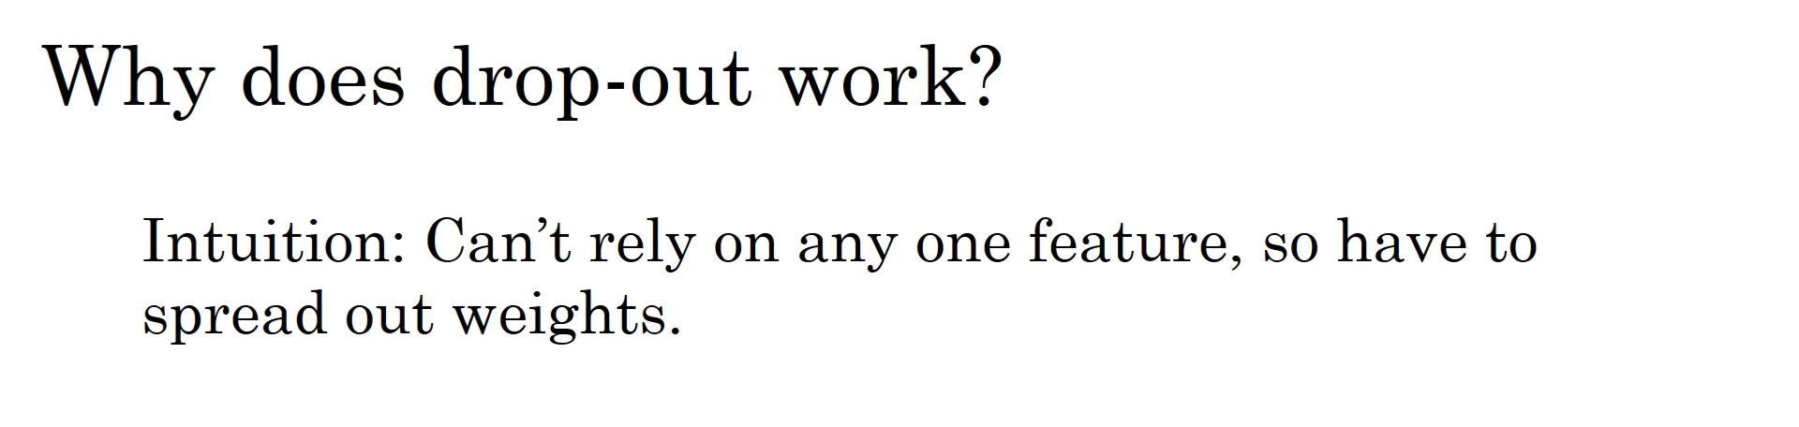
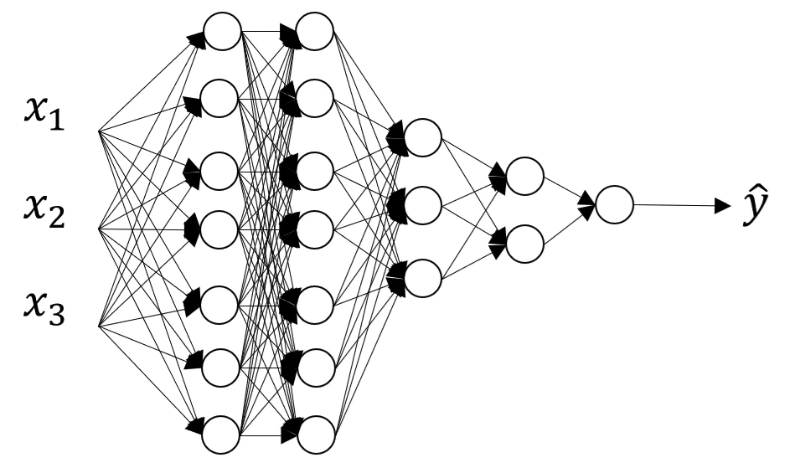
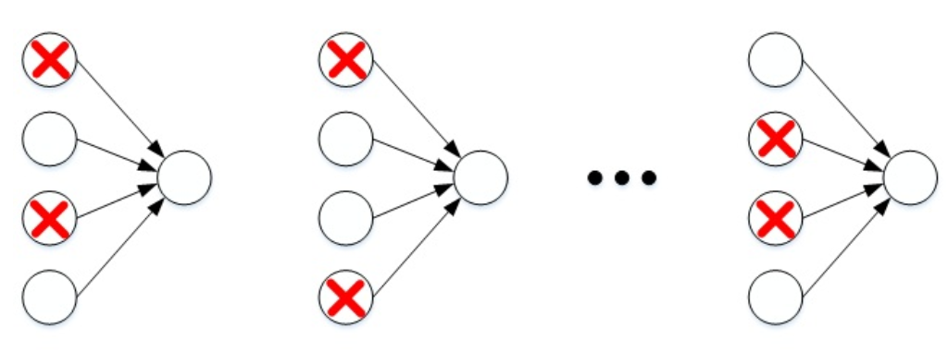
1.0
1.0
0.8
1.0
0.7
0.5
Notes:
The network can’t rely on any one feature because it can go away by random. So the network don’t put to much weight on any input but spread out weights.
This makes weight of every input smaller and thus has regularization effect.
We can apply different keep_prob for different layer. Layers with bigger weight matrix tends to cause overfitting more and should have smaller keep_prob.

Slide 20



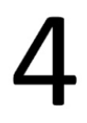

Other regularization methods (data augmentation)
Notes:
Adding more real data might be costly. In the problem of image recognition, the existing image can be flipped horizontally, vertically, rotated at any angle, zoomed or expanded, etc.
In digital recognition, you can also rotate or distort the original digital picture arbitrarily, or add some noise.

Slide 21
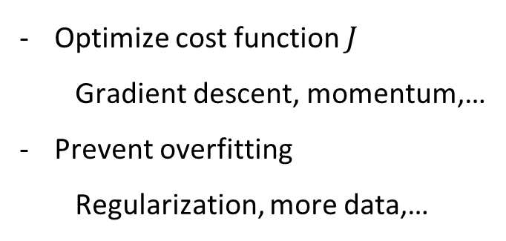
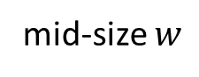
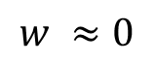
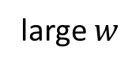
Other regularization methods (early stopping)
Optimize cost function $J$
Gradient descent, momentum,…
Prevent overfitting
Regularization, more data,…
stop
dev error or J
train error or J
$$w ≈0$$
mid-size $w$
large $w$
#iteration
Notes:
At the beginning, w is small. After many iteration, w get bigger and create overfitting at some point.
The two problems of optimizing cost function and preventing overfitting need to be solved by separate tools.
However, with overstopping, we deal with two problems at once at have trace-off (cannot get both good at the same time).
The advantage of early stopping is that we just need to run gradient descent one time to get mid-size w without the need of changing lambda and other regularization hyperparameter.

Slide 22
Setting up your optimization

Slide 23
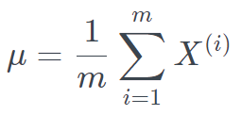
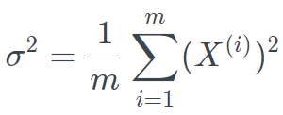




Normalizing training set
Note: use the same $μ$ and $σ$ for normalizing test set
Notes:
When training neural networks, normalizing inputs can increase the speed of training.

Slide 24





Why normalize input?
Notes:
Since we use the same learning rate alpha for all dimension, in dimension with small scale, the gradient descent easily overshooting and create oscillation.
Normalization allow you to use larger learning rate and thus speed up training.

Slide 25









Vanishing/exploding gradient
$g\left(z\right)=z$ $b^{[l]}=0$
$$w^{[l]}=\left[\begin{matrix}1.5 & 0 \\ 0 & 1.5\end{matrix}\right]$$
$$0.5$$
$$\hat{y}=w^{\left[L\right]}{\left[\begin{matrix}1.5 & 0 \\ 0 & 1.5\end{matrix}\right]}^{L−1}$$
$$0.5$$
$$0.5$$
$$0.5$$
Notes:
One of the problems of training deep neural network is vanishing and exploding gradient.
It means that when training deep network, the derivative (slope) can sometimes very big or very small and that make training difficult.

Slide 26









Vanishing/exploding gradient
hidden layer 1
hidden layer 2
$db$ in each nodes after initilization
$$\left\|db^{[l]}\right\|$$
$$\left\|db^{[l]}\right\|$$
$$\left\|db^{[l]}\right\|$$
number of iteration
number of iteration
number of iteration
Notes:
The orange bars indicate the value of the gradien db in each node right after initilization.
The gradient in early layer is much smaller than that in later layers.
The more number of layers, the smaller gradient of early layers.
In this case, we have a vanishing gradient problem.
Since gradient is directly proportional to the learning speed, small gradient means slow learning.
Note that the update of w is directly proportional to db.
http://neuralnetworksanddeeplearning.com/chap5.html

Slide 27







What causes vanishing/exploding gradient?
$σ\left(z\right)≤1/4$ and $w^{\left[l\right]}≤1$ $→w^{\left[l\right]}σ^{′}\left(z^{\left[l\right]}\right)≤1/4$
$→$ vanishing gradient in early layers
If $w^{[l]}$ is big, $w^{\left[l\right]}σ^{′}\left(z^{\left[l\right]}\right)>1$
$→$ exploding gradient in early layers
$→$ large update (unstable network)
Notes:
http://neuralnetworksanddeeplearning.com/chap5.html

Slide 28



Weight Initialization in a Deep Network
larger $n^{[l]}$ $→$ smaller $w_{ij}$
$$var\left(w_{ij}\right)=\frac{1}{n}$$
w [ l ] = np . random . randn ( $n^{\left[ l \right]}$, $n^{\left[ l − 1 \right]}$) * np . sqrt ( 1 / $n^{\left[ l − 1 \right]}$)
tanh activation
w [ l ] = np . random . randn ( $n^{\left[ l \right]}$, $n^{\left[ l − 1 \right]}$) * np . sqrt ( 2 / $n^{\left[ l − 1 \right]}$)
RELU activation
w [ l ] = np . random . randn ( $n^{\left[ l \right]}$, $n^{\left[ l − 1 \right]}$) * np . sqrt ( $\frac{2}{n^{\left[ l − 1 \right]}+n^{[l]}}$)

Slide 29











Numerical Approximations of Gradients
$$f^{′}\left(x\right)≈\frac{f\left(x+ε\right)−f\left(x\right)}{ε}$$
$→$ High error $O(ε)$
$$f(x+ε)$$
$$f(x)$$
$$f^{′}\left(x\right)≈\frac{f\left(x+ε\right)−f\left(x−ε\right)}{ε}$$
$→$ Low error $O\left(ε^{2}\right)$
$$f(x−ε)$$
$x$-$ε$
$$x$$
$x$+$ε$
Notes:
An important test of Back Propagation neural network is gradient checking. Its purpose is to check whether the gradient descent algorithm is correct during the back propagation process.

Slide 30



$$J\left(W^{\left[1\right]},b^{[1]},…,W^{\left[L\right]},b^{\left[L\right]}\right)=J\left(θ\right)$$
Is d$θ$ the gradient of $J\left(θ\right)$?

Slide 31





Gradient check
$$J\left(W^{\left[1\right]},b^{[1]},…,W^{\left[L\right]},b^{\left[L\right]}\right)=J\left(θ\right)=J\left(θ_{1},θ_{2},…,θ_{i},…\right)$$
For each $i$:
$$≈dθ\left[i\right]=\frac{∂J}{∂θ_{i}}$$
Check:
$>{10}^{−3}$ $→$ bug
Note:
Don’t check in training (only to debug)
Remember if cost function has regularization
Doesn’t work with dropout
$$ε={10}^{−7}$$

Slide 32
Optimization algorithms

Slide 33

Epoch: one pass through training set (with include T mini-Batches)

Slide 34





Slide 35


Slide 36


Slide 37







Exponentially Weighted Averages
Notes:
The temperature data has noise and large jitter.
If you want to see the overall change trend of temperature in half a year, you can smooth the daily temperature by moving average (moving average)

Slide 38







$$V_{t}=βV_{t−1}+\left(1−β\right)θ_{t}$$
$V_{t}$ is approximately the average over
$≈\frac{1}{1−β}$ days
$β=0.9$ : $≈$ 10 days temperature
$β=0.98$ : $≈$ 50 days
$β=0.5$ : $≈$ 2 days
Notes:
When betta is lager, the model (Vt) adapt more slowly to the change of temperature and express more latency.

Slide 39





$$∗$$
$V_{100}=$ $0.1{×{0.9}^{0}×θ}_{100}$
$+0.1×{0.9}^{1}×θ_{99}$
$+0.1×{0.9}^{2}×θ_{98}$
$+0.1×{0.9}^{3}×θ_{97}$
$+0.1×{0.9}^{4}×θ_{96}$
$+…$

Slide 40


Notes:
The advantage of exponentially weighted averages is that it take very little memory.
We just need to keep one real number to calculate the average.

Slide 41








$$β=0.9$$
$$β=0.98$$
$$v_{t_{correct}}≔\frac{v_{t}}{1−β^{t}}$$
Bias correction
$V_{0}=0$
$V_{1}=0.98{×V}_{0}+0.02×θ_{1}$
$V_{2}=0.98×V_{1}+0.02×θ_{2}$
$=0.0196×θ_{1}+0.02×θ_{2}$
${V_{1}}_{correct}=\frac{0.02{×θ}_{1}}{0.02}=θ_{1}$
${V_{2}}_{correct}=\frac{0.0196×θ_{1}+0.02×θ_{2}}{0.0396}=0.495×θ_{1}+0.505×θ_{2}$
0
Notes:
Bias correction gives better estimate in early stage.

Slide 42





Momentum
On iteration t:
Compute $dW, db$ on current mini-batch.
$V_{dW}=βV_{dW}+\left(1−β\right)d_{W}$
$V_{db}=βV_{db}+\left(1−β\right)d_{b}$
$W=W−αV_{dW} , b=b−αV_{db}$
Hyperparameter: $α,β$
$β=0.9$ (average last 10 gradient)
Notes:
There is a optimization algorithm called momentum (or gradient descent with momentum) that almost always faster than standard gradient descent.
In basic, we will calculate the exponentially weighted average of the gradient and use this average values to update parameters.
The oscilation slow down the learning. If you use large learning rate, you can have overshotting.

Slide 43








Wrong direction
Righ direction
We need to reduce the update in the wrong direction.
With many dimension, the projections on the wrong directions usually larger than that of right direction.
On iteration t
Intuition: Slow down update on wrong direction
If vertical (wrong direction) are $w_{1},w_{4},…,b_{3},b_{8},…$
Then $\sqrt{S_{dW_{1}}},$ $\sqrt{S_{dW_{4}}}$, …, $\sqrt{S_{db_{3}}}$, $\sqrt{S_{db_{8}}}$,… are usually larger
After reducing update in wrong direction, we can use larger $α$
$$≠0$$

Slide 44








Adam (Adaptive Moment Estimation) optimization algorithm
Hyperparameter: $α,β_{1},β_{2},ε$
Compute $dW,db$ using current mini-batch
$β_{1}=0.9$
$β_{2}=0.999$
$ε={10}^{−8}$

Slide 45







Slowly reduce $α$

Slide 46
Hyperparameter tuning

Slide 47


Tuning process
$α$: Learning factor
$β$: Momentum gradient descent factor
$β_{1},β_{2},ε$: Adam algorithm parameters
#layers: Number of neural network layers
#hidden units: the number of neurons in each hidden layer
learning rate decay: learning factor decay parameter
mini-batch size: the number of samples contained in the batch training sample
0.9
0.9 , 0.999 , ${10}^{−8}$

Slide 48



Searching scheme
Use random (don’t use grid)
Coarse to fine
Notes:
Some hyperparameters are more important than others. With grid, it takes 25 tries to test 5 values of each hyperpameters. With randome, we can test 25 values of each hyperparameters.

Slide 49


Using an Appropriate Scale
#layers, #hidden units $→$ uniform random sample (linear scale)
For other hyperparameter such as $α$
Linear interval [a,b]
m = np.log10(a)
n = np.log10(b)
r = np.random.rand()
r = m + (n-m)*r
r = np.power(10,r)
Linear
Log
Notes:
We need to choose a suitable scale for exploring different values of hyperparameters.
For #layers and #hidden units, both are positive integers and can be uniformly randomly sampled, that is, the scale of each hyperparameter change is the same.

Slide 50







Hyperparameters for exponentially weighted averate
$$r∈\left[−3,−1\right]$$
$$1−β={10}^{r}$$
$$β=1−{10}^{r}$$
$$β=0.9 … 0.999$$
10
1000
$$1−β=0.1 … 0.001$$
$$β: 0.9000 → 0.9005$$
($0.0005$ difference)
10
10.05
$$β: 0.9990 → 0.9995$$
($0.0005$ difference)
1000
2000

Slide 51


Slide 52

Batch Normalization
Notes:
In the rise of deep learning, one of the most important idea is batch normalization.
Batch normalization is a technique proposed in 2015 for improving the speed, performance of NN.
It make the network much more roburst in the choice of the range of hyperparameters that work well.
And it make it easy to train very deep network.
It is used to normalize the input layer by re-centering and re-scaling.

Slide 53






$$a^{\left[2\right]}$$
$$W^{\left[3\right]},b^{[3]}$$
Can we normalize $a^{[2]}$ to train $W^{\left[3\right]},b^{[3]}$ faster?
$→$ Normalize $Z^{[2]}$
Notes:
You remember that normalizing input feature can speed up learning.
In deeper model, you have input, a[1], a[2], a[3].

Slide 54






Implement Batch Normalization
Batch normalize $Z^{[l]}={[z}^{\left[l\right]\left(1\right)},z^{[l](2)},…,z^{\left[l\right]\left(m\right)}]$
$γ$ and $β$ are used to set whatever mean and variance to $Z^{\left[l\right]}$
Learnable parameters
Notes:
After normalization, z has zero means and variance 1.
We don’t want hidden unit ALWAYS has mean zero and variance 1.

Slide 55

























Recap normal network
$$W^{\left[2\right]},b^{[2]}$$
$$W^{\left[1\right]},b^{[1]}$$
$$g^{[1]}$$
$$g^{[2]}$$
$$x_{1}$$
$$z_{1}^{[1]}→a_{1}^{[1]}$$
$$z_{1}^{[2]}→a_{1}^{[2]}$$
$$x_{2}$$
$$\hat{y}$$
$$g^{[1]}$$
$$g^{[2]}$$
$$x_{3}$$
$$z_{2}^{[1]}→a_{2}^{[1]}$$
$$z_{2}^{[2]}→a_{2}^{[2]}$$
$$W^{\left[1\right]},b^{[1]}$$
$$g^{[1]}$$
$$W^{\left[2\right]},b^{[2]}$$
$$g^{[2]}$$
$$X$$
$$Z^{\left[1\right]}$$
$$A^{\left[1\right]}$$
$$Z^{\left[2\right]}$$
$$A^{\left[2\right]}$$
$$…$$

Slide 56

































Adding batch norm to a network
$$W^{\left[1\right]},b^{[1]}$$
$$β^{\left[1\right]},γ^{[1]}$$
$$g^{[1]}$$
$$W^{\left[2\right]},b^{[2]}$$
$$β^{\left[2\right]},γ^{[2]}$$
$$g^{[2]}$$
$$x_{1}$$
$$z_{1}^{[1]}→{{\tilde{z}}_{1}}^{\left[1\right]}→a_{1}^{[1]}$$
$$z_{1}^{[2]}→{\tilde{z}}_{1}^{\left[2\right]}→a_{1}^{[2]}$$
$$x_{2}$$
$$\hat{y}$$
$$β^{\left[1\right]},γ^{[1]}$$
$$g^{[1]}$$
$$β^{\left[2\right]},γ^{[2]}$$
$$g^{[2]}$$
$$x_{3}$$
$$z_{2}^{[1]}→{\tilde{z}}_{2}^{\left[1\right]}→a_{2}^{[1]}$$
$$z_{2}^{[2]}→{\tilde{z}}_{2}^{\left[2\right]}→a_{2}^{[2]}$$
$$W^{\left[1\right]},b^{[1]}$$
$$β^{\left[1\right]},γ^{\left[1\right]}$$
$$g^{[1]}$$
$$W^{\left[2\right]},b^{[2]}$$
$$β^{\left[2\right]},γ^{\left[2\right]}$$
$$g^{[2]}$$
$$X$$
$$Z^{\left[1\right]}$$
$${\tilde{Z}}^{\left[1\right]}$$
$$A^{\left[1\right]}$$
$$Z^{\left[2\right]}$$
$${\tilde{Z}}^{\left[2\right]}$$
$$A^{\left[2\right]}$$
$$…$$
Parameter: $W^{\left[1\right]},b^{\left[1\right]},W^{\left[2\right]},b^{[2]},…$
$β^{\left[1\right]},γ^{\left[1\right]},β^{\left[2\right]},γ^{\left[2\right]},…$
$W^{\left[1\right]}≔W^{\left[1\right]}−αd_{W}^{\left[1\right]}$,$b^{\left[1\right]}≔b^{\left[1\right]}−αd_{b}^{\left[1\right]}$,…
$β^{\left[1\right]}≔β^{\left[1\right]}−αd_{β}^{[1]}$,$γ^{\left[1\right]}≔γ^{\left[1\right]}−αd_{γ}^{[1]}$,…
Update:
Notes:
Note that parameter beta here is not beta used for Adam optimization algorithm.

Slide 57



Implement batch norm with mini-batch
for $t = 1… num$(where $num$ is the number of Mini Batch):
In each $X^{\left\{t\right\}}$perform forward propagation:
Use Batch Norm to transform $Z^{\left\{t\right\}[l]}$ to ${\tilde{Z}}^{\left\{t\right\}[l]}$
Use Back propagation to calculate the gradient: $d_{W}^{\{t\}\left[l\right]},d_{γ}^{\{t\}\left[l\right]},d_{β}^{\left\{t\right\}[l]}$
Update parameters:
$$Z^{\left[l\right]}=W^{[l]}a^{[l−1]}+b^{[l]}$$
Notes:
After we adding bias b to Z, we then normalize Z and remove the effect of b.
Therefore, when implement batch norm, we only have three parameters: w, gamma, and beta

Slide 58































Calculate gradient with batch norm
$$W^{\left[1\right]},b^{[1]}$$
$$β^{\left[1\right]},γ^{\left[1\right]}$$
$$g^{[1]}$$
$$W^{\left[2\right]},b^{[2]}$$
$$β^{\left[2\right]},γ^{\left[2\right]}$$
$$g^{[2]}$$
$$X$$
$$Z^{\left[1\right]}$$
$${\tilde{Z}}^{\left[1\right]}$$
$$A^{\left[1\right]}$$
$$Z^{\left[2\right]}$$
$${\tilde{Z}}^{\left[2\right]}$$
$$A^{\left[2\right]}$$
$$…$$
$da^{[L]}=\frac{∂L}{∂a^{[L]}}$
$d{\tilde{z}}^{[L]}=\frac{∂L}{∂{\tilde{z}}^{[L]}}=\frac{∂L}{∂a^{[L]}}\frac{∂a^{[L]}}{∂{\tilde{z}}^{[L]}}=da^{\left[L\right]}{g^{\left[L\right]}}^{′}\left({\tilde{z}}^{\left[L\right]}\right)$
$dβ^{\left[L\right]}=\frac{∂L}{∂β^{[L]}}$ ; $dγ^{\left[L\right]}=\frac{∂L}{∂γ^{[L]}}$
$dz^{\left[L\right]}=\frac{∂L}{∂z^{[L]}}$
$dW^{[L]}=\frac{∂L}{∂W^{[L]}}=\frac{∂L}{∂z^{[L]}}\frac{∂z^{[L]}}{∂W^{[L]}}=dz^{[L]}{a^{\left[L−1\right]}}^{T}$
$da^{[L−1]}=\frac{∂L}{∂a^{[L−1]}}=\frac{∂L}{∂z^{[L]}}\frac{∂z^{[L]}}{∂a^{[L−1]}}={W^{\left[L\right]}}^{T}dz^{[L]}$
$dz^{[L−1]}=\frac{∂L}{∂z^{[L−1]}}=\frac{∂L}{∂a^{[L−1]}}\frac{∂a^{[L−1]}}{∂z^{[L−1]}}=da^{\left[L−1\right]}{g^{\left[L−1\right]}}^{′}\left(z^{\left[1\right]}\right)={W^{\left[2\right]}}^{T}dz^{[2]}$* ${g^{\left[L−1\right]}}^{′}\left(z^{\left[L−1\right]}\right)$
…
$$W^{\left[L\right]},b^{[L]}$$
$$β^{\left[L\right]},γ^{\left[L\right]}$$
$$g^{[L]}$$
$$…$$
$$A^{\left[L−1\right]}$$
$$Z^{\left[L\right]}$$
$${\tilde{Z}}^{\left[L\right]}$$
$$A^{\left[L\right]}$$
$$ℒ$$
$$dA^{\left[L−1\right]}$$
$$dZ^{\left[L\right]}$$
$$d{\tilde{Z}}^{\left[L\right]}$$
$$dA^{[L]}$$
$$dW^{\left[L\right]}$$
$$dγ^{\left[L\right]}$$
$$dβ^{\left[L\right]}$$

Slide 59











Batch norm derivation
$dz_{norm}^{(i)\left[L\right]}=\frac{∂L}{∂z_{norm}^{(i)\left[L\right]}}=\frac{∂L}{∂{\tilde{z}}^{\left[L\right]}}\frac{∂{\tilde{z}}^{\left[L\right]}}{∂Z_{norm}^{\left(i\right)\left[L\right]}}=d{\tilde{z}}^{\left[L\right]}γ$
$dσ^{2[L]}=\frac{∂L}{∂σ^{2\left[L\right]}}=\sum_{i=1}^{m}{dz_{norm}^{(i)\left[L\right]}}\left(z^{(i)\left[L\right]}−μ^{\left[L\right]}\right)\left(−\frac{1}{2}\right){\left(σ^{2\left[L\right]}+ε\right)}^{−3/2}$
$dμ^{[L]}=\frac{∂L}{∂μ^{\left[L\right]}}=\left(\sum_{i=1}^{m}{dz_{norm}^{(i)\left[L\right]}}\frac{−1}{\sqrt{σ^{2\left[L\right]}+ε}}\right)+dσ^{2[L]}\frac{\sum_{i=1}^{m}{−2\left(z^{\left(i\right)[L]}−μ^{\left[L\right]}\right)}}{m}$
$dz^{(i)\left[L\right]}=\frac{∂L}{{∂z}^{(i)\left[L\right]}}=dz_{norm}^{(i)\left[L\right]}\frac{1}{\sqrt{σ^{2\left[L\right]}+ε}}+dσ^{2\left[L\right]}\frac{2\left(z^{\left(i\right)[L]}−μ^{\left[L\right]}\right)}{m}+dμ^{\left[L\right]}\frac{1}{m}$
$dγ^{\left[L\right]}=\frac{∂L}{∂γ^{\left[L\right]}}=\sum_{i=1}^{m}{d{\tilde{z}}^{(i)\left[L\right]}z_{norm}^{(i)\left[L\right]}}$
$dβ^{[L]}=\frac{∂L}{∂β^{\left[L\right]}}=\sum_{i=1}^{m}{d{\tilde{z}}^{(i)\left[L\right]}}$
$$μ^{\left[L\right]},{σ^{2}}^{\left[L\right]}$$
$$β^{\left[L\right]},γ^{\left[L\right]}$$
$$Z^{\left[L\right]}$$
$$Z_{norm}^{\left[L\right]}$$
$${\tilde{Z}}^{\left[L\right]}$$
$$dZ^{\left[L\right]}$$
$$dZ_{norm}^{\left[L\right]}$$
$$d{\tilde{Z}}^{\left[L\right]}$$
$$dγ^{\left[L\right]}$$
$$dβ^{\left[L\right]}$$

Slide 60


Batch norm at test time
$μ, σ^{2}$: estimate using exponentially weighted average (across mini-batch)
$X^{\left\{1\right\}} X^{\left\{2\right\}} X^{\left\{3\right\}} … X^{\left\{t\right\}}$
$μ^{\left\{1\right\}\left[l\right]}$ $μ^{\left\{2\right\}[l]}$ $μ^{\left\{3\right\}[l]}$ … $μ^{\left\{t\right\}[l]}$ $→$ $μ$
$μ^{\left\{1\right\}\left[l\right]}$ $μ^{\left\{2\right\}[l]}$ $μ^{\left\{3\right\}[l]}$ … $μ^{\left\{t\right\}[l]}$ $→$ $σ^{2}$
$$z_{norm}=\frac{z−μ}{\sqrt{σ^{2}+ε}} \tilde{z}=γz_{norm}+β$$

Slide 61
Multi-class classification

Slide 62








$C=\#classes=4$ (cat, dog, chick, other)
$$P(other|x)$$
$$P(cat|x)$$
$$P(dog|x)$$
$$P(chick|x)$$
$$n^{\left[L\right]}=C=4$$

Slide 63











$$\frac{e^{5}}{167.3}=0.842$$
layer L
$$\frac{e^{2}}{167.3}=0.042$$
$$\frac{e^{−1}}{167.3}=0.002$$
$$\frac{e^{3}}{167.3}=0.114$$
$$z^{\left[L\right]}=\left[\begin{aligned}5 \\ 2 \\ −1 \\ 3\end{aligned}\right]$$
$$\sum_{i=1}^{C}{e^{z_{i}^{[L]}}}=176.3$$
Activation function:
$${\hat{y}=a}^{\left[L\right]}=\left[\begin{aligned}0.842 \\ 0.042 \\ 0.002 \\ 0.114\end{aligned}\right]$$

Slide 64



Understanding softmax
Hard max
$$\left[\begin{aligned}1 \\ 0 \\ 0 \\ 0\end{aligned}\right]$$
Soft max

Slide 65









Loss function softmax
$$−\log\left({\hat{y}}_{2}\right)$$
$→{\hat{y}}_{2}$ needs to be close to 1
Cost function on $m$ training example:

Slide 66



Backprop:
$$dz^{[L]}=\frac{∂J}{∂z^{\left[L\right]}}=a_{i}−y_{i}$$
$dZ^{\left[L\right]}=A−Y$

Slide 67
Future topics
Introduction to Neural Network and Deep Learning
Improving Deep Neural Networks
Convolutional Neural Networks
Sequence Models
Deep Learning in data mining and big data analysis
Other architectures and current research activity in deep learning

